Slide 1
Energizing Your Company for Enormous Success
presented by LAMERE
3/25/2014 7:21 AM

Slide 2
SUCCESSFUL COMPANIES
One quality all successful, high-performance companies have is a very high level of Energy
In such companies we see a number of wonderful qualities, including-

Slide 3
a clear sense of direction
motivated, enthusiastic people
deep sense of pride
high performance, great execution
solid teamwork
effective, streamlined systems
great coordination among people and activities
things occur on time and in a reliable way
market hungers for its products and services
quality of products and services is very high
stimulating and creative place to work
reputation of the company is very solid
strong growth is a continuous experience
there is non-stop, ever-accelerating profitability

Slide 4
How do companies generate these marvelous results?

Slide 5
They do it by harnessing Energy

Slide 6
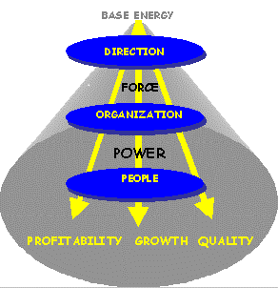
By engaging the Energy Conversion process
Let’s see that in action.

Slide 7
Here we see how energy flows and intensifies as it moves from the top of the organization down through all levels of the firm.
(the gray cylinder is the energy)

Slide 8
The original, base energy of the company is harnessed by the direction it is given by the leaders of the firm. This includes its mission, goals, values, and strategies for implementation.
As a result, the base energy becomes a directed Force for accomplishment.

Slide 9
The goals and strategies from the top then flow through the various aspects of the company’s organization – including its job positions, activities, systems, and projects.
As a result the Force of energy is further intensified into a Power.
We can think of it as a lens that intensifies, amplifies, and concentrates the energy into a vast Power for results to occur. High performance companies readily experience this dynamic.

Slide 10
The energy of the company is further expanded and intensified by the people who carry out the goals through the job positions, activities, projects, et al they engage in.
When they do this with great skill and positive attitudes, then the enormous Power of energy that had been harnessed is now released throughout the company, creating magnificent results.
The results come in the form of huge increases in productivity which we measure as vast revenue growth and profitability.

Slide 11
Highly successful companies follow this process to a large degree.
Of course, they can perfect it, and by doing so bring about even greater productivity, revenues and profits.
In fact at each point a company significantly engages in this process, profits double, and double again; often 10 times or more in a very few years.
The possibilities are thus endless, and the results can be infinite-like, which the most successful of companies have more or less realized.

Slide 12
UNSUCCESSFUL COMPANIES
On the other hand, companies that are not successful have low, erratic, diffused levels of energy.
They are rife with problems, including –

Slide 13
high levels of stress fatigue and burnout chaos and confusion skepticism and doubt poor morale and lack of enthusiasm conflicts within the organization no clear sense of direction departments pursuing conflicting priorities no sense of pride lack of teamwork breakdown of and lacking systems poor coordination and communication | duplication of work jobs that are not clear products and services that are subpar complaints from customers on the rise a continuous shortage of skilled people no real spark or inspiration or creativity people have no idea where their future lies sudden eruptions of public relation issues decline in the company’s reputation revenue is stagnating or declining profits are little or nowhere to be found

Slide 14
How do companies fall into this unenviable, troubled state?

Slide 15
What would that look like?
It turns out that in poorly performing companies the energy flow is opposite of what highly successful firms experience. Instead of energy progressively intensifying, it is deflected and wasted, thereby reducing any chance for serious business success.

Slide 16
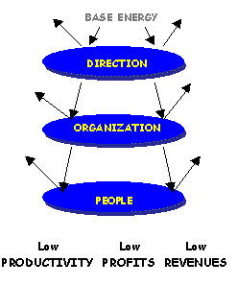
We see how the energy gets deflected at each step along the way, preventing it from building up into a force and power for accomplishment, leading to low productivity, revenue, and profits.

Slide 17
The original energy of the company is not harnessed because there is inadequate direction given by the firm.
As a result, the energy is deflected and diffused. It does not build up into a Force for success.

Slide 18
We also see how the organization is inadequate to carry through even the limited direction it receives from the top – as there are problems in the activities, systems, projects, etc. to carry out the goals.
As a result inadequate Power is generated in the company, and misery in various forms spreads, as described above.

Slide 19
The remaining energy of the company is further deflected by the people who haven’t the skills, the motivation, the intensity, and the right attitudes to see the goals through, if they even know what they are.
As a result, when they carry out their work, it ends in poor productivity and results, hence low revenues and profits -- even losses.
In this way, unsuccessful companies are unable to harness the necessary energy to drive them to enormous success.

Slide 20
What can we do about this troubling situation?

Slide 21
To rectify this situation we need to somehow refocus the lenses to build up the energy into a Force and Power which will drive success, enabling the company to double or more its revenues or profits in two years or less.
How do we do that?

Slide 22
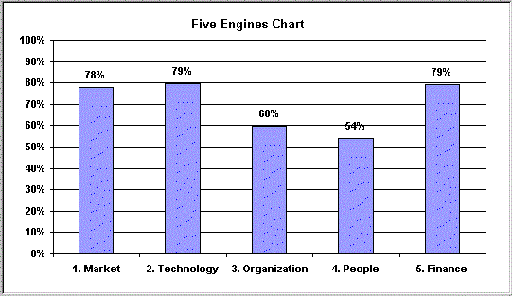
We refocus the lenses of the company and expand the Energy that drives it by upgrading the company’s Five Engines of Growth. They are-
Market, Technology, Organization, People, and Finance

Slide 23
Let’s examine each of the five engines that drive the company

Slide 24
MARKET is the first engine. Market is the meeting of a need in society which the company aims to serve.
Among the aspects of this engine are:
Knowing what the customer wants
The ability to please the customer at all levels
The quality of marketing strategies to get the attention of potential customers
The quality of the sales effort to secure orders, contracts, etc. from the customer

Slide 25
TECHNOLOGY (aka Products & Services) is the know-how for producing a product or providing a service which meets the needs of the market. It’s the way you perceive the products and services you provide, and the methods you employ to generate them.
Among the aspects of this engine are:
The ability to identify and then produce the type of products and services the public wants
The quality and innovation level of the products and services offered
The ability to create the best value (quality for the price) available in the market of its products and services
Having the right, skilled people to research, produce, and support its products and services
The level of productivity of systems, activities, projects, etc. to generate products and services

Slide 26
ORGANIZATION provides the structure and systems which direct the people and utilize the capital and technology to provide the products and services that meet the needs of the market.
Among the aspects of this engine are:
The proper structure of the company, including job positions, responsibilities, and authority
The smoothness of operations, including activities, systems, projects, etc. to carry out company goals and objectives
The level of coordination and communication in the company
The right movement of information, knowledge, ideas throughout the firm, including speed and accuracy
The level of cleanliness and orderliness throughout the company
The right flow and availability of resources, materials in the company

Slide 27
PEOPLE are those managers and workers who contribute their energies and ideas, talents and skills to deliver the products or services to meet the market need.
Among the aspects of this engine are:
The degree that people are fully cognizant of the aspirations and goals of the company, and are motivated to carry them out
The level of enthusiasm and job satisfaction of the staff
The degree of freedom, individuality, and feedback of the staff
The level of well-being, devoid of stress of people in their work
The level of training and career development people have within the firm
The staff’s level of satisfaction with their compensation and benefits
The productivity of people in their work compared to what is expected

Slide 28
FINANCE (CAPITAL) in one form or another capitalizes the company at all levels, including the four other engines so it can achieve its goals.
Among the aspects of this engine are:
The degree to which the company utilizes all possible sources of capital from banks, suppliers’ credit, financial markets, etc.
How up to date accounts are, including payable and receivables, inventory status, cost accounting indicators, etc.
The degree to which budgets are created and maintained
The degree to which the company minimizes costs, eliminates waste, and makes all systems more efficient.

Slide 29
Each of the Five Engines and their sub-components is a vast reservoir of potential energy which can be released and utilized for vast accomplishment, which translates as enormous revenue and profits.

Slide 30
By raising the performance on the least developed engines, including the problematic factors within, you can shed all of the troubling qualities that have kept your firm down, releasing a titanic amount of energy throughout the company, driving it to the stars.

Slide 31
Which engine(s) should you focus on?

Slide 32
ANY SINGLE ENGINE -- Drawing on the power of any one of them is enough to catapult a company into rapid growth.
LOWEST TWO ENGINES -- Certainly improving on the lowest two or three of the five will be of enormous help, as it clears away most of the bottlenecks, releasing tremendous amounts of energy, driving the company to double its profits or more very quickly.
ALL FIVE ENGINES -- In fact, if all five engines are raised to their heights, profitability increases at an exponential level.
OUR SUGGESTION -- We recommend you work with the lowest two engines and its sub-factors, plus a few of the other lower scored factors in the other engines.

Slide 33
Whichever strategy you employ, doubling or more of profits within two years or less is virtually certain.

Slide 34
What about Five Engines in Your Company?
Think for a moment about your company or about a company you know well.
Which of these five engines have been most instrumental in propelling growth?
Which have been the weakest; ones that seem to be holding it back?
What are several ways have the weakest held the company back?
What do you think you can do to improve the performance on the weakest engines? I.e. what can you do to strengthen them?

Slide 35
Your Role as Leader
What determines the relative strength, balance and coordination of the five engines in a company and therefore what energizes it?
It starts with the people at the top - their understanding, their attitudes and their preferences.
It is therefore your role to not only determine the direction of the company, but to be aware of its strengths and weaknesses.
KEY: By understanding the various aspects of each engine, by fully committing to get at the bottom of problem areas and overcoming them, and by communicating the desire to do so will be a powerful force to move the company forward to achieve its stated aims; actually exceed them by far.

Slide 36
What can we do together?

