Slide 1
Keys to Infinite Business Success
Roy Posner
LAMERE Management Advisors
last updated: 10/11/2018 9:59 AM

Slide 2
Part 1: INFINITE-LIKE SUCCESS
∞

Slide 3
Apple
Google
Amazon
Alibaba
Facebook
Microsoft
What do they all have in common?

Slide 4
Infinite-Like Success
∞
They are all extremely successful companies
They have created successes that seem to defy what is possible
Several are reaching $1 Trillion in valuation!
It seems like they are becoming Infinite-like

Slide 5
“Inside” As Well!
And what about INSIDE these companies?
very stimulating and creative place to work
people are extremely motivated, enthusiastic
a very clear sense of direction from top
market hungers for its products, services
reputation of company is very solid
deep sense of pride
high performance, great execution
solid teamwork
effective, streamlined systems
great coordination among people and activities
things occur on time and in a reliable way
quality of products and services is very high
strong growth is a continuous experience
there is non-stop, ever-accelerating profitability

Slide 6
What We Can Learn
How did they get that way?
And can anyone learn from their experiences, and build something similar?
Do they all have something in common that we can learn from?
Is there some method or process we can learn that will enable us to become infinitely successful as well?

Slide 7
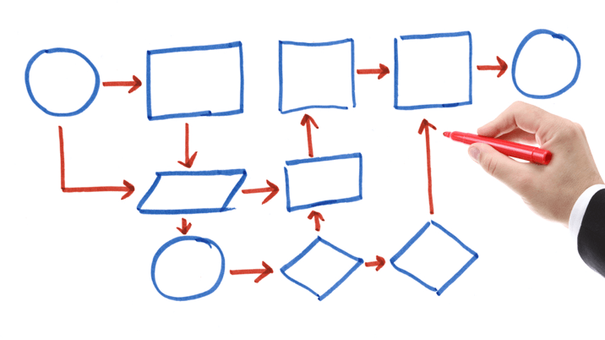
Fundamental Process
We believe there is
We believe there is a fundamental process that each of these companies, and thousands more like them have followed that enabled their infinite-like success
It’s a process that releases a fantastic amount of energy, that then gets channeled into vast, infinite-like results

Slide 8
Energy Conversion Process
Then what is the process that can create such infinite-like success?
It is the process by which ENERGY is directed into a Force, and organized into a Power, that enables these infinite-like results
We call it the “Energy Conversion Process”

Slide 9
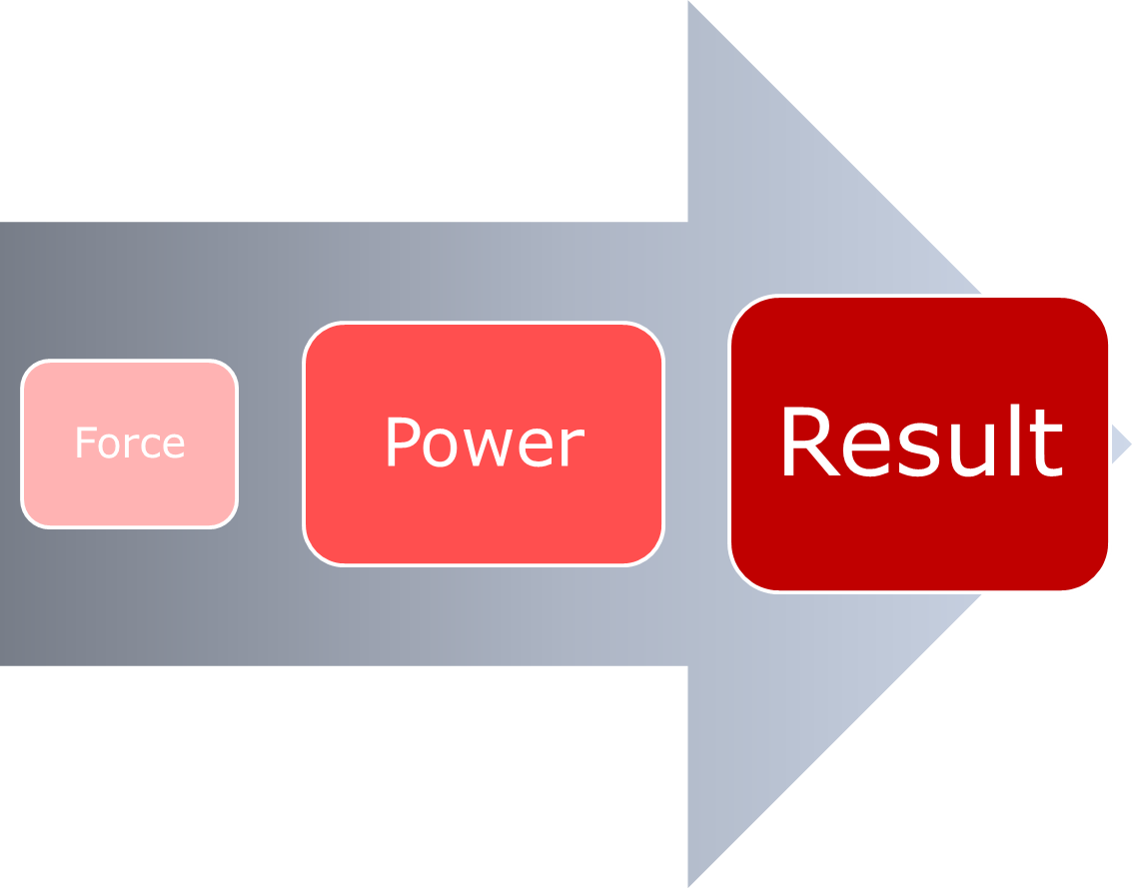
Part 2: ENERGY CONVERSION PROCESS

Slide 10
Energy
The source of all accomplishment in life is ENERGY
Whether Energy for an Individual, a Business, or of Society itself
The more energy for any of these entities, the more they can accomplish
Then what is this “Energy” we are talking about?

Slide 11
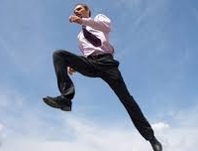
Expressions of Human Energy
s
For us as individuals, Energy expresses, is released in several different ways. As-
PHYSICAL energy – through movement and functioning of our body
VITAL/Emotional energy – through our desires, willfulness, feelings, emotions; and by engaging with others and life
MENTAL energy –through thinking, understanding, believing, and envisioning

Slide 12
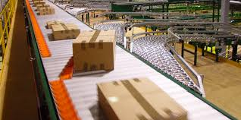
Expressions of Business Energy
s
Then how does “Energy” express in a business?
There are also physical, vital, and mental type energies emanating from the firm. Eg -
--the speed by which products are manufactured (physical)
--the enthusiasm and vigor which invoices are processed (vital)
--the interest in the ideas that takes place in meetings (mental)
It is the intensity and vibrancy of carrying out these functions that determines the overall ENERGY in the firm
… And the more ENERGY released - the greater its Force and Power – the greater the Accomplishment!

Slide 13
Energy Conversion
Accomplishment thus occurs when Raw Energy is harnessed, expanded and converted into material forms
How does that happen? How does it move from Energy to Reality?
Accomplishment takes place to the degree the business-
gives DIRECTION to that Energy, directing it into a FORCE;
then ORGANIZES that Force into a POWER;
then implements it by PEOPLE through right ACTION
The result is ENORMOUS success, revenues, profits, and joy

Slide 14
ENERGY CONVERSION -- Raw energy is Directed into a Force, Organized into a Power, and Acted upon, making it Real in the world – resulting in vast Revenues, Profits, Joy
Force
Power
Results
Directed
Organized
Acted Upon
Vast
REVENUE
PROFITS
JOY
Starting
Energy

Slide 15
Analogy of Harnessing a Child’s Energy
A child’s energy is boundless
But it gets scattered, and can lead to trouble if not harnessed
Through family values and education, the child’s boundless energy is harnessed
That energy is further acted upon, enabling the child to become a productive person in society
Well, the same is true for a company:
when the firm’s energy is harnessed it becomes a Force and Power that leads to vast material results.

Slide 16
Envisioning the Future
So where do we start?
How do we begin harnessing the energy for Accomplishment?
How do we give Direction to the Energy?
We develop a Plan. Sometimes in the form of a Strategic Plan or a Business Plan
How do we begin our plan for accomplishment?
It begins with a Vision of what we want to accomplish
The Vision begins to give subtle form to the energy

Slide 17
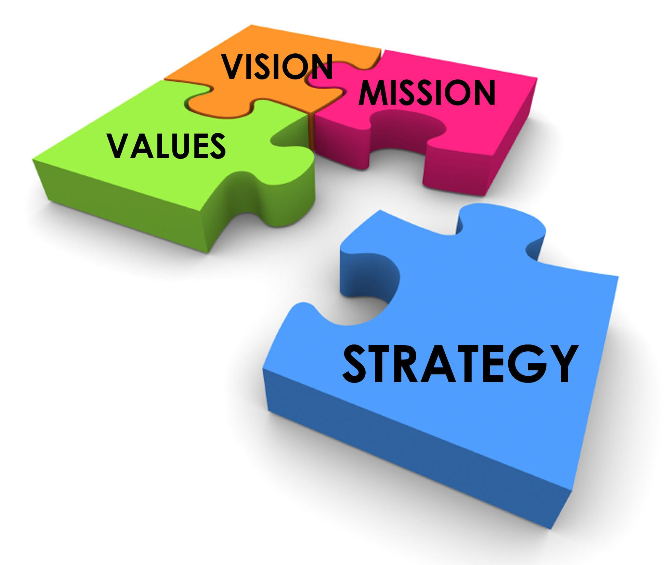
Aspects of the Plan
We then establish-
the Mission for our overall plan
the specific Goals we aim to achieve
the various Strategies to implement the Goals
the Action to-dos to implement the decided-on strategies

Slide 18
PLAN:
Mission Statement > Goals > Strategies > Actions/To Dos
Force
Power
Result
Directed
Organized
Acted Upon
Vast
REVENUE
PROFITS
HARMONY
Raw energy is Directed into a Force, Organized into a Power, and Implemented as Real in the world

Slide 19
Example: Consciously Following the Energy Conversion Process
XYZ Company comes together as a group and make the firm decision to expand our company in sales and quality of products (DIRECTION: energy turns into a Force)
We develop specific goals, strategies, and action plans to make that happen.
--Increase sales 50% in next two years
--Introduce 3 new products
(ORGANIZED: Force turns into a Power)
It is then executed by people, with skill and right attitude to make it happen.
--100 people with high skills are hired
--R&D department begins research on several approaches
--Several projects are undertaken to make it happen
(ACTION: Power is acted upon, bringing great results)
Vast sales, revenues, profits, joy!
Directed
Organized
Acted Upon
RESULTS!

Slide 20
Part 3: 5 GROWTH ENGINES

Slide 21
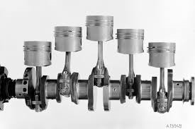
Insuring Results
Q: How do we insure that our Plan for the company is fully implemented? Insuring the Process works?
A: We need to evaluate the company in its various components
It is by making sure that the Engines of growth that drive the company are fully functional

Slide 22
Plan and Business Engines
What then are the Engines that insure
our Plan will be fully realized?

Slide 23
The Company consists of Five Growth Engines:
Market, Technology, Organization, People, Capital

Slide 24
Effect of Strong Engines
When all 5 engines are functioning well, the company accomplishes its Plan in full
I.e. energy is focused, tuned into a Force, and then a Power for vast accomplishment
The result is perfect execution of the plan
Enormous revenues and profits follow
… plus Joy emerges at all levels in the firm!

Slide 25
Effect of Weak Engines
However, when several engines are weak, the plan cannot be executed
The Force and Power gets diffused, blocking the Plan from being executed
Revenues and Profits tumble
Potential for success turns into failure, or simply mediocrity
The atmosphere of company turns sour
X

Slide 26
Effect of Weak Organization engine
Eg in the Organization engine, the PRODUCTION system is sputtering; not able to keep up
As a result, the strategic Plan to increase sales fails to materialize
In other words, the Energy fails to develop into a Power; and poor Results follow
X

Slide 27
So to get the desired results in the Energy Conversion Process, we need to-
examine each of the Engines of the firm
see which parts of each Engine are lacking
determine overall strength of each Engine
make plans to improve what is deficient
With that in mind, let’s examine each of the 5 Growth Engines in greater detail.

Slide 28
MARKET Engine

Slide 29
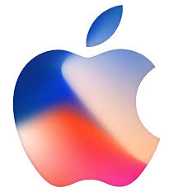
Aspects of MARKET - 1
MARKET consists of the individuals and organizations to whom we wish to sell our products and services
The key aspects of this engine ARE-
Knowing what the customer wants
Eg Apple knows that people want smartphone, apps, and services to automate, make more manageable various aspects of their lives
Ability to please the customer at all levels
Eg Apple wants the devices to be easy to use, beautifully designed, making their lives not only more productive but also enjoyable

Slide 30
Aspects of MARKET - 2
Marketing Strategies to get the attention of potential customers, clients
Eg Apple seeks to sell to the mid and higher end of the market, through direct sales at their web site, and through their Apple stores
Sales efforts to secure orders, contracts, etc. from customers, clients
Eg Apple believes it should have stores in the best, most accessible locations worldwide, and give maximum, pleasant attention to its customers in every sales encounter

Slide 31
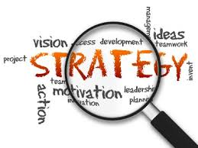
Example MARKET Strategy
What’s an example of a Market strategy to maximize that engine?
One is being aware of and seizing opportunities in the market; especially where change is taking place.
Eg being aware of changes in one’s industry, and the opportunities presented
Eg FedEx saw the opportunity to develop very rapid overnight mail and package delivery for companies and individuals around the world
Also being aware of new developments in society; perceiving the waves of social change
Steve Jobs at Apple saw the need for an easy to use personal computer for the masses, which led him to create the Macintosh and its user friendly interface.

Slide 32
MARKET Engine Maximum Effect
When the four Market-oriented aspects, and various strategies are implemented at the maximum level-
the energy conversion process is enhanced
i.e. the starting energy develops into a Force and then a Power that when implemented creates Great Results
In other words, our Mission and Plan is far more likely to be executed in full, enabling vast sales and profits

Slide 33
TECHNOLOGY Engine*
*aka “Products, Services”

Slide 34
Aspects of TECHNOLOGY
TECHNOLOGY are the things the firm will actually offer, sell to the market
Key aspects of this engine are-
Ability to identify and produce products, services the market wants or needs
Internal capacity to create the products, services through talents of its people, utilizing company systems
--(people) Google has an almost fanatical view of hiring the best people
--(systems) Intel has very pinpointed method of looking at metrics to see if various activities and systems are reaching hoped for results
Ability to produce innovative, new products and services
Apple intensely focuses on innovation by blending technologies into new, breakthrough products, services

Slide 35
Technology - INNOVATION Drivers
s
Innovation in Technology is the greatest driver of success in the modern economy
What are some areas of innovation?
New Business Models – eg Airbnb, Uber, Cryptocurrency
New Underpinnings – Blockchain, Artificial Intelligence (AI)
IT Everywhere – eg “Internet of Everything”
Supply Chain Revolution – Amazon, Alibaba
Value Chain Revolution – Custom Orders, On-Time Delivery

Slide 36
ORGANIZATION Engine

Slide 37
Aspects of ORGANIZATION
a
ORGANIZATION is the company operations and functioning that enable the execution of all the other engines
Among the key aspects of this engine are-
Proper structure of the company – including-
-right lines of authority, job positions, responsibilities, operating procedures
-separations of firms into activities, systems, divisions, and departments
Smoothness of operations within and between these units of organization to carry out company’s mission and goals
Right movement of information, knowledge, ideas throughout the firm through the structure

Slide 38
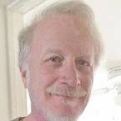
ORGANIZATION – Reflections
“Organization is the foundation of the company that enables it to thrive”
It is the least appreciated Engine, but the foundation of all the others!
Imagine society without organization! Same with business.
The greater and more perfectly their organization, the more likely the other aspects of the firm will thrive.
Intel Experience
Most fast-paced companies lack organization
Consulting & training experience with fast growing companies bears this out

Slide 39
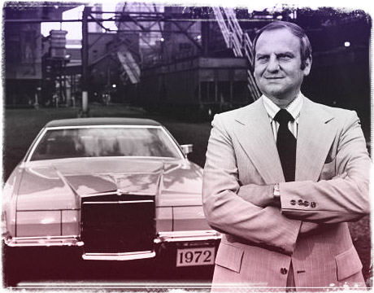
Chrysler: Revamping Organizational Parts
Chrysler Debacle
Lee Iacocca
Turned around company by revamping the Organizational parts
Revamped Structure, of firm - Managerial Jobs, Duties, Activities, Systems, et al - turning company around
Paid off loan from government within a year!, and thrived.
Perhaps greatest turnaround story in business history!

Slide 40
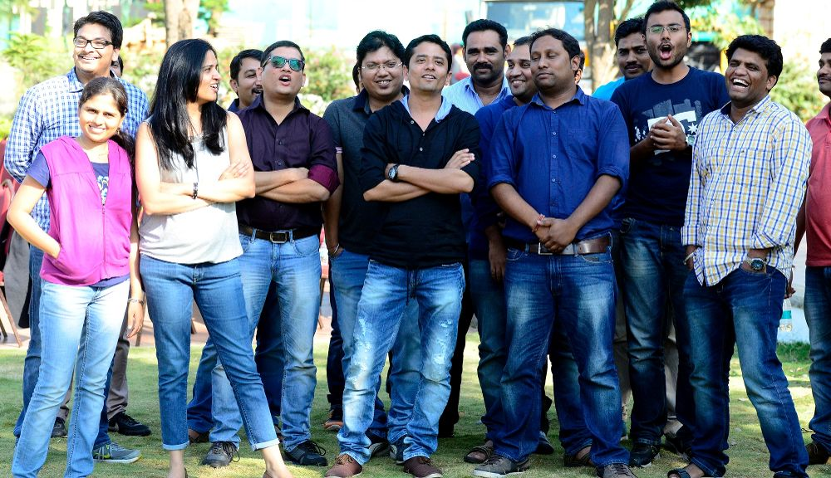
PEOPLE Engine

Slide 41
Aspects of PEOPLE
PEOPLE are the individuals who will develop, sell, and support the products and services, utilizing their talents, skills, and ideas
The key aspects of this engine are-
Awareness of staff of the aspirations and goals of the company, and their motivation to carry them out
Productivity of people in their work
Level of freedom, individuality, and feedback of the staff
Google’s freedom and individuality
Level of well-being, devoid of stress of people in their work
Level enthusiasm and job satisfaction of the staff

Slide 42
CAPITAL Engine

Slide 43
Aspects of CAPITAL
CAPITAL is the money needed to keep operations running and people paid so the plan of selling products services to the market through the organization can be achieved.
The key aspects of this engine are-
The degree to which the company utilizes all possible sources of capital from banks, suppliers’ credit, financial markets, etc.
How up-to-date accounts are, including payable and receivables, inventory status, cost accounting indicators, etc.
The degree to which budgets are created and maintained
The degree to which the company minimizes costs, eliminates waste, and makes all systems more efficient.

Slide 44
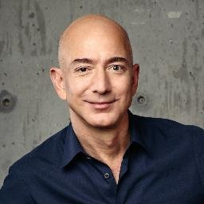
Jeff Bezos’ Money Values
s
Jeff Bezos is head of Amazon, largest e-commerce company in the world
Nearing $1Trillion in valuation
Yet company made no profits until 3 years ago!
--Money was reinvested in better products and services
--To create lower costs for the user
He shunned short-term profits, and now has ½ a trillion dollars in his pocket!
Valued Growth over Profits
Power of “Values” (next)

Slide 45
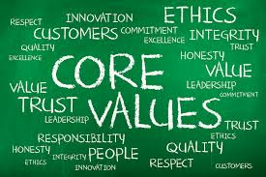
Part 4: BUSINESS VALUES

Slide 46
Steve Jobs’ Journey to India
a
He went searching for spiritual truth in India.
However, through difficulties he encountered, it steeled him to come back, to focus, and “change the world”
He wanted to be like great inventor Thomas Edison of the modern times
“Change the world” was the dominating value that guided his life, and career.

Slide 47
The Nature of Core Business Values
a
Then what are Values?
They are our deepest beliefs about life
For a company a value is a belief, a mission, or a philosophy that is really meaningful
An example of a core business value is: "Customer Satisfaction"
Another example is "Being Ethical and Truthful.“
The companies with the greatest success deeply subscribe to several values

Slide 48
Companies Subscribing to Values
a
Apple belief in the values of Ease of Use and Service to Society
Apple created user friendly Mac and then IPhone, overcoming people's fear of technology.
Marriott's values of Systemization and Standardization
Enabled it to seamlessly duplicate its standard model hotel hundreds of times across the country
Google valuing Individuality and Experimentation
Eg encouraging employees to work on their own projects that have nothing to do with Google

Slide 49
Applying Values to 5 Engines
a
The most powerful way to energize each of the 5 Engines is by applying Core Business Values
Eg the value of Customer Delight energizes the Market engine (company doing everything it can to support the needs of their customers)
The value of Reliability can energize any of the engines.
Of product reaching the customer (Market engine)
Of the systems working without fail (Organization engine)
VALUES

Slide 50
Values, Engines, & Energy Conversion
When Values are implemented it supports the power of that engine(s) which in turn helps turn our Aspirations for the company into a Force and then a Power for great Accomplishment.
VALUES
Infinite
Results

Slide 51
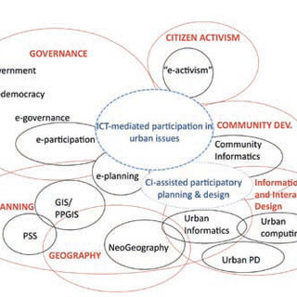
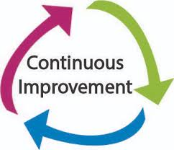
Applying Values to Smallest Acts
a
Values have the greatest effect when they are applied to the smallest acts in the company.
Eg the value of Continuous Improvement is not only a General value that can subscribed to by the overall company, but applied to the smallest detail like-
insuring that the HR recruitment database is continually improved with new features
marketing follow-up letters are continually perfected
sales training is continually evaluated and upgraded

Slide 52
Applying Values to Smallest Acts
“The most powerful corporate values are not the ones that are preached and practiced by top management. They are the ones that penetrate through all layers of the organisation, down to the lowest levels, and the smallest details. (Garry Jacobs)

Slide 53
Example: XYZ Company Applying Values
a
In Plan, XYZ company aims to increase sales by 50% in the next two years
XYZ also aims to double profits
To help this along, it wants to strengthen the Organization and People engines, which are weak
It also wants to apply several Values throughout the company:
Customer Delight, Continuous Improvement, Innovation, an Integrity and Honesty
It is dedicated to applying those values at every detail level, in every act throughout the company, in each of the 5 engines!

Slide 54
Sets of Values Used by Companies -1
a
Companies tend to embrace several values at once in their culture
The most successful ones take each one very seriously
Here is an example of two well-known companies’ sets of values

Slide 55
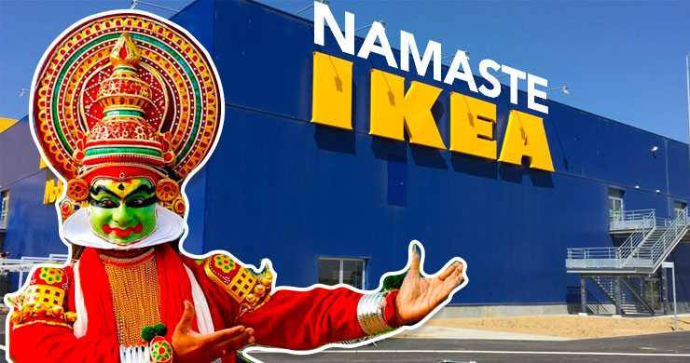
Sets of Values Used by Companies -2
American Express
Customer Commitment
Quality
Integrity
Teamwork
Respect for People
Good Citizenship
A Will to Win
Personal Accountability
IKEA
Humbleness
Willpower
Leadership by example
Daring to be different
Togetherness and enthusiasm
Cost-consciousness
Constant desire for renewal
Accept and delegate responsibility

Slide 56
Sample Core Business Values
Accountability
Collaboration
Community
Continuous Improvement
Customer Delight
Embrace Change
Empathy
Empowerment
Entrepreneurial Spirit
Equality for All
Excellence
Family Feeling
Focus
Giving Back
Go the Extra Mile
Growth and Learning
Harmony, Unity
Honesty, Truthfulness
Humility, Non-Egoistic
Innovation
Integrity
Non-Wastage
Open Culture
Passion
Perfection
Performance
Positive Attitude
Punctuality
Quality of Products, Services
Reliability
Respect for environment
Respect Others
Responsiveness
Self-givingness
Simplicity
Skills & Training
Speed of operations
Support Our People
Taking Responsibility
Teamwork
Tolerance, Open minded
Transparency
Trust
Work as Fun

Slide 57
KEYS TO INFINITE BUSINESS SUCCESS -Energy Conversion Process -5 Growth Engines -Core Business Values Vast, Infinite-Like Success!

Slide 58
Keys to Infinite Business Success Roy Posner
©2018

